Slide 1
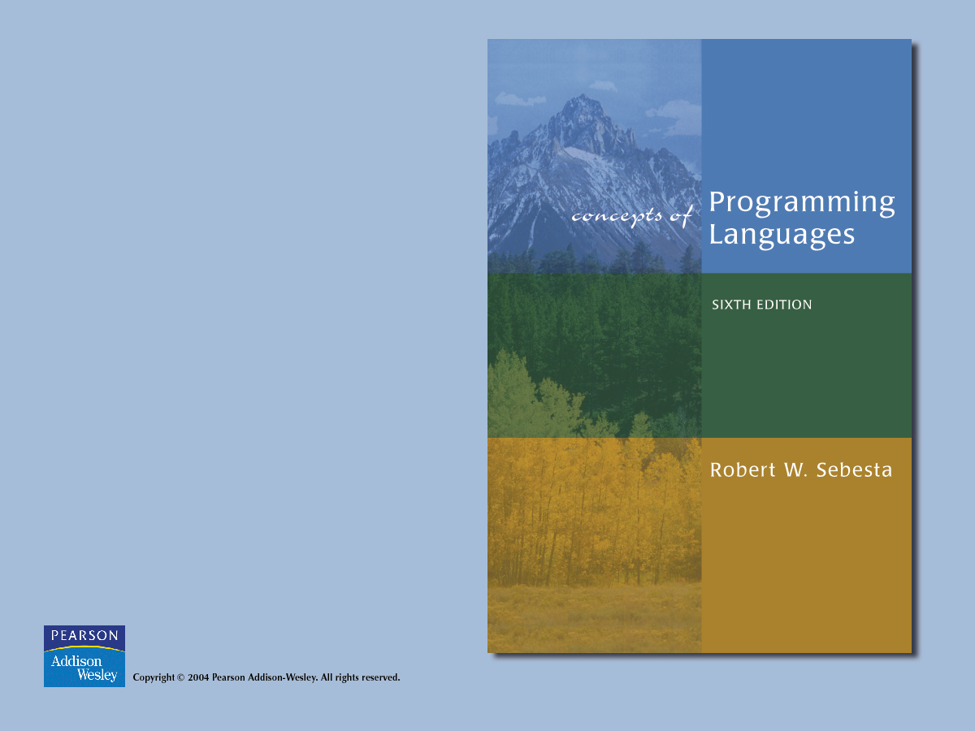
Chapter 9
Subprograms

Slide 2

Chapter 9 Topics
Introduction
Fundamentals of Subprograms
Design Issues for Subprograms
Local Referencing Environments
Parameter-Passing Methods
Parameters that are Subprogram Names
Overloaded Subprograms
Generic Subprograms
Design Issues for Functions
User-Defined Overloaded Operators
Coroutines

Slide 3
Introduction
Two fundamental abstraction facilities
  Process abstraction (this chapter)
  Data abstraction (Chapter 11)

Slide 4
Fundamentals of Subprograms
General characteristics of subprograms:
  1. A subprogram has a single entry point
  2. The caller is suspended during execution of the called subprogram
  3. Control always returns to the caller when the called subprogram’s execution terminates

Slide 5
Fundamentals of Subprograms
Basic definitions:
  A subprogram definition is a description of the actions of the subprogram abstraction
  A subprogram call is an explicit request that the subprogram be executed
  A subprogram header is the first line of the definition, including the name, the kind of subprogram, and the formal parameters
  The parameter profile of a subprogram is the number, order, and types of its parameters

Slide 6
Fundamentals of Subprograms
Basic definitions (continued):
  The protocol of a subprogram is its parameter profile plus, if it is a function, its return type
  A subprogram declaration provides the protocol, but not the body, of the subprogram
  A formal parameter is a dummy variable listed in the subprogram header and used in the subprogram
  An actual parameter represents a value or address used in the subprogram call statement

Slide 7
Fundamentals of Subprograms
Actual/Formal Parameter Correspondence:
1. Positional
2. Keyword
  e.g. SORT(LIST => A, LENGTH => N);
  Advantage: order is irrelevant
  Disadvantage: user must know the formal parameter’s names
  Default Values:
  e.g. procedure SORT(LIST : LIST_TYPE;
  LENGTH : INTEGER := 100);
  ...
  SORT(LIST => A);

Slide 8
Fundamentals of Subprograms
Procedures provide user-defined statements
Functions provide user-defined operators

Slide 9
Design Issues for Subprograms
1. What parameter passing methods are provided?
2. Are parameter types checked?
3. Are local variables static or dynamic?
4. Can subprogram definitions appear in other subprogram definitions?

Slide 10
Design Issues for Subprograms
5. What is the referencing environment of a passed subprogram?
6. Can subprograms be overloaded?
7. Are subprograms allowed to be generic?

Slide 11
Local referencing environments
If local variables are stack-dynamic:
  Advantages:
    a. Support for recursion
    b. Storage for locals is shared among some subprograms
  Disadvantages:
    a. Allocation/deallocation time
    b. Indirect addressing
    c. Subprograms cannot be history sensitive
Static locals are the opposite

Slide 12
Local referencing environments
Language Examples:
1. FORTRAN 77 and 90 - most are static, but the implementor can choose either (User can force static with SAVE)
2. C - both (variables declared to be static are) (default is stack dynamic)
3. Pascal, Java, and Ada - dynamic only

Slide 13
Parameter Passing Methods
We discuss these at several different levels:
  Semantic models: in mode, out mode, inout mode
  Conceptual models of transfer:
  1. Physically move a value
  2. Move an access path

Slide 14
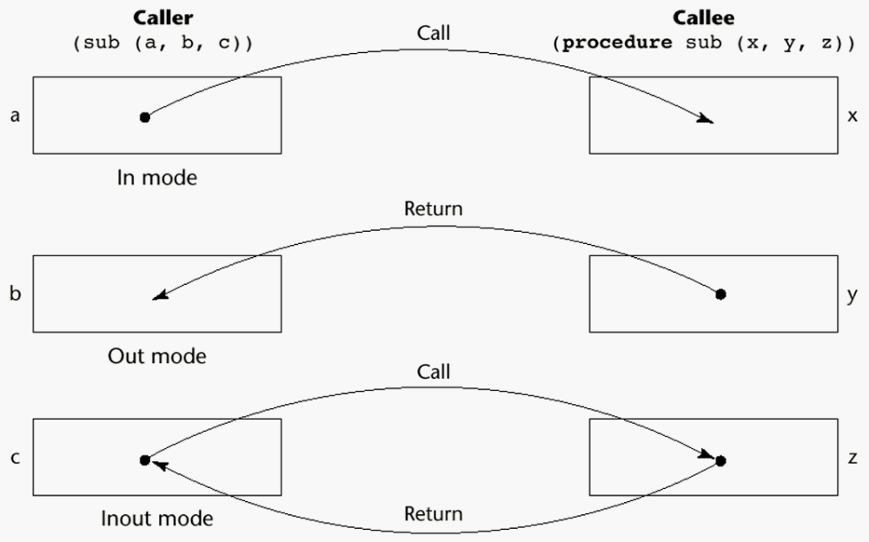
Models of Parameter Passing

Slide 15
Parameter Passing Methods
Implementation Models:
1. Pass-by-value (in mode)
  Either by physical move or access path
  Disadvantages of access path method:
    Must write-protect in the called subprogram
    Accesses cost more (indirect addressing)
  Disadvantages of physical move:
    Requires more storage (duplicated space)
    Cost of the moves (if the parameter is large)

Slide 16
Parameter Passing Methods
2. Pass-by-result (out mode)
  Local’s value is passed back to the caller
  Physical move is usually used
  Disadvantages:
    If value is passed, time and space
    In both cases, order dependence may be a problem
  e.g.
  procedure sub1(y: int, z: int);
  ...
  sub1(x, x);
  Value of x in the caller depends on order of assignments at the return

Slide 17
Parameter Passing Methods
3. Pass-by-value-result (inout mode)
  Physical move, both ways
  Also called pass-by-copy
  Disadvantages:
    Those of pass-by-result
    Those of pass-by-value

Slide 18
Parameter Passing Methods
4. Pass-by-reference (inout mode)
  Pass an access path
  Also called pass-by-sharing
  Advantage: passing process is efficient (no copying and no duplicated storage)
  Disadvantages:
    Slower accesses

Slide 19
Parameter Passing Methods
Pass-by-reference - disadvantages (cont)
  b. Allows aliasing:
    i. Actual parameter collisions:
e.g. procedure sub1(a: int, b: int);
...
sub1(x, x);

Slide 20
Parameter Passing Methods
Pass-by-reference - disadvantages (cont)
  ii. Array element collisions:
  e.g.
  sub1(a[i], a[j]); /* if i = j */
  Also, sub2(a, a[i]); (a different one)
  iii. Collision between formals and globals
  Root cause of all of these is: The called subprogram is provided wider access to nonlocals than is necessary
  Pass-by-value-result does not allow these aliases (but has other problems!)

Slide 21
Parameter Passing Methods
5. Pass-by-name (multiple mode)
  By textual substitution
  Formals are bound to an access method at the time of the call, but actual binding to a value or address takes place at the time of a reference or assignment
  Purpose: flexibility of late binding

Slide 22
Parameter Passing Methods
5. Pass-by-name (multiple mode continued)
  Resulting semantics:
    If actual is a scalar variable, it is pass-by-reference
    If actual is a constant expression, it is pass-by-value
    If actual is an array element, it is like nothing else
    e.g.
    procedure sub1(x: int; y: int);
    begin
    x := 1;
    y := 2;
    x := 2;
    y := 3;
    end;
    sub1(i, a[i]);

Slide 23
Parameter Passing Methods
5. Pass-by-name (multiple mode, continued)
  If actual is an expression with a reference to a variable that is also accessible in the program, it is also like nothing else
  e.g. (assume k is a global variable)
  procedure sub1(x: int; y: int; z: int);
  begin
  k := 1;
  y := x;
  k := 5;
  z := x;
  end;
  sub1(k+1, j, i);

Slide 24
Parameter Passing Methods
Disadvantages of pass by name:
  Very inefficient references
  Too tricky; hard to read and understand
Language Examples:
1. FORTRAN
  Before 77, pass-by-reference
  77 - scalar variables are often passed by value-result
2. ALGOL 60
  Pass-by-name is default; pass-by-value is optional

Slide 25
Parameter Passing Methods
3. ALGOL W
  Pass-by-value-result
4. C
  Pass-by-value
5. Pascal and Modula-2
  Default is pass-by-value; pass-by-reference is optional
6. C++
  Like C, but also allows reference type parameters, which provide the efficiency of pass-by-reference with in-mode semantics

Slide 26
Parameter Passing Methods
7. Ada
  All three semantic modes are available
  If out, it cannot be referenced
  If in, it cannot be assigned
8. Java
  Like C++, except only references

Slide 27
Parameter Passing Methods
Type checking parameters (now considered very important for reliability)
  FORTRAN 77 and original C: none
  Pascal, FORTRAN 90, Java, and Ada: it is always required
  ANSI C and C++: choice is made by the user

Slide 28
Parameter Passing Methods
Implementing Parameter Passing
  ALGOL 60 and most of its descendants use the run-time stack
  Value - copy it to the stack; references are indirect to the stack
  Result - same
  Reference - regardless of form, put the address in the stack
  Name - run-time resident code segments or subprograms evaluate the address of the parameter; called for each reference to the formal; these are called thunks
    Very expensive, compared to reference or value-result

Slide 29
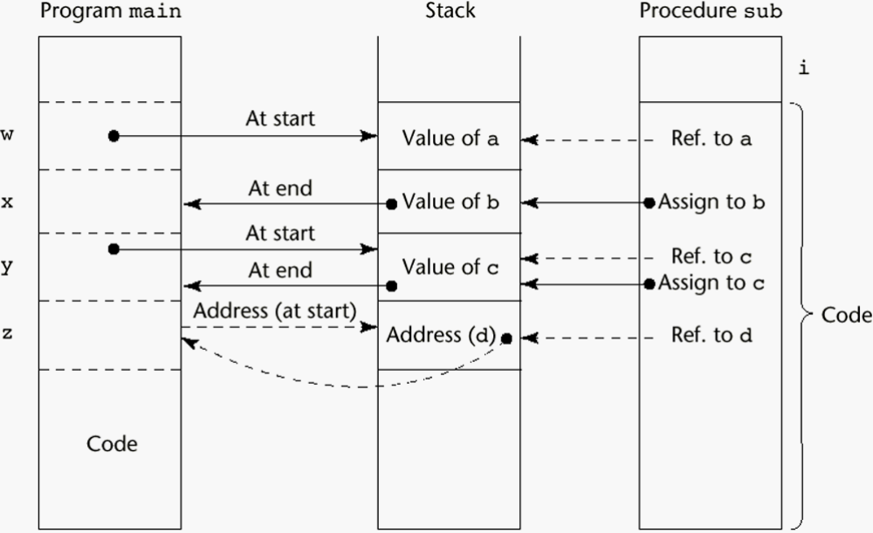
Stack Implementation of Parameter-Passing

Slide 30
Parameter Passing Methods
Ada
  Simple variables are passed by copy (value-result)
  Structured types can be either by copy or reference
  This can be a problem, because
    a) Of aliases (reference allows aliases, but value-result does not)
    b) Procedure termination by error can produce different actual parameter results
    Programs with such errors are “erroneous”

Slide 31
Parameter Passing Methods
Multidimensional Arrays as Parameters
  If a multidimensional array is passed to a subprogram and the subprogram is separately compiled, the compiler needs to know the declared size of that array to build the storage mapping function

Slide 32
Parameter Passing Methods
C and C++
  Programmer is required to include the declared sizes of all but the first subscript in the actual parameter
  This disallows writing flexible subprograms
  Solution: pass a pointer to the array and the sizes of the dimensions as other parameters; the user must include the storage mapping function, which is in terms of the size parameters

Slide 33
Parameter Passing Methods
Pascal
  Not a problem (declared size is part of the array’s type)
Ada
  Constrained arrays - like Pascal
  Unconstrained arrays - declared size is part of the object declaration (Java is similar)

Slide 34
Parameter Passing Methods
Pre-90 FORTRAN
  Formal parameter declarations for arrays can include passed parameters, e.g.
SUBPROGRAM SUB(MATRIX, ROWS, COLS, RESULT)
INTEGER ROWS, COLS
REAL MATRIX (ROWS, COLS), RESULT
...
END

Slide 35
Parameter Passing Methods
Design Considerations for Parameter Passing
  1. Efficiency
  2. One-way or two-way
  These two are in conflict with one another!
  Good programming => limited access to variables, which means one-way whenever possible
  Efficiency => pass by reference is fastest way to pass structures of significant size
  Also, functions should not allow reference parameters

Slide 36
Parameters that are Subprogram Names
Issues:
  1. Are parameter types checked?
  Early Pascal and FORTRAN 77 do not
  Later versions of Pascal and
  FORTRAN 90 do
  Ada does not allow subprogram parameters
  Java does not allow method names to be passed
  as parameters
  C and C++ - pass pointers to functions; parameters can be type checked

Slide 37
Parameters that are Subprogram Names
2. What is the correct referencing environment for a subprogram that was sent as a parameter?
  Possibilities:
  a. It is that of the subprogram that enacted it
  Shallow binding
  b. It is that of the subprogram that declared it
  Deep binding
  c. It is that of the subprogram that passed it
  Ad hoc binding (Has never been used)

Slide 38
Parameters that are Subprogram Names
For static-scoped languages, deep binding is most natural
For dynamic-scoped languages, shallow binding is most natural

Slide 39
Parameters that are Subprogram Names
Example: sub1
sub2
sub3
call sub4(sub2)
sub4(subx)
call subx
call sub3
What is the referencing environment of sub2 when it is called in sub4?
  Shallow binding => sub2, sub4, sub3, sub1
  Deep binding => sub2, sub1

Slide 40
Overloaded Subprograms
Def: An overloaded subprogram is one that has the same name as another subprogram in the same referencing environment
C++ and Ada have overloaded subprograms built-in, and users can write their own overloaded subprograms

Slide 41
Generic Subprograms
A generic or polymorphic subprogram is one that takes parameters of different types on different activations
Overloaded subprograms provide ad hoc polymorphism
A subprogram that takes a generic parameter that is used in a type expression that describes the type of the parameters of the subprogram provides parametric polymorphism

Slide 42
Generic Subprograms
Examples of parametric polymorphism
  1. Ada
  Types, subscript ranges, constant values, etc., can be generic in Ada subprograms and packages, e.g.
generic
type ELEMENT is private;
type VECTOR is array (INTEGER range <>)
of ELEMENT;
procedure GENERIC_SORT(LIST: in out
VECTOR);

Slide 43
Generic Subprograms
procedure GENERIC_SORT(LIST: in out VECTOR)
is
TEMP : ELEMENT;
begin
for INDEX_1 in LIST'FIRST ..
INDEX_1'PRED(LIST'LAST) loop
for INDEX_2 in INDEX'SUCC(INDEX_1) ..
LIST'LAST loop
if LIST(INDEX_1) > LIST(INDEX_2) then
TEMP := LIST (INDEX_1);
LIST(INDEX_1) := LIST(INDEX_2);
LIST(INDEX_2) := TEMP;
end if;
end loop; -- for INDEX_1 ...
end loop; -- for INDEX_2 ...
end GENERIC_SORT;

Slide 44
Generic Subprograms
procedure INTEGER_SORT is new GENERIC_SORT(
ELEMENT => INTEGER;
VECTOR => INT_ARRAY);

Slide 45
Generic Subprograms
Ada generics are used to provide the functionality of parameters that are subprograms; generic part is a subprogram
Example:
generic
with function FUN(X : FLOAT) return FLOAT;
procedure INTEGRATE(LOWERBD : in FLOAT;
UPPERBD : in FLOAT;
RESULT : out FLOAT);

Slide 46
Generic Subprograms
procedure INTEGRATE(LOWERBD : in FLOAT;
UPPERBD : in FLOAT;
RESULT : out FLOAT) is
FUNVAL : FLOAT;
begin
...
FUNVAL := FUN(LOWERBD);
...
end;
INTEGRATE_FUN1 is new INTEGRATE(FUN => FUN1);

Slide 47
Generic Subprograms
Examples of parametric polymorphism
  2. C++
  Templated functions
  e.g.
template <class Type>
Type max(Type first, Type second) {
return first > second ? first : second;
}

Slide 48
Generic Subprograms
C++ template functions are instantiated implicitly when the function is named in a call or when its address is taken with the & operator
Another example:
template <class Type>
void generic_sort(Type list[], int len) {
int top, bottom;
Type temp;

Slide 49
Generic Subprograms
for (top = 0; top < len - 2; top++)
for (bottom = top + 1; bottom < len - 1;
bottom++) {
if (list[top] > list[bottom]) {
temp = list [top];
list[top] = list[bottom];
list[bottom] = temp;
} //** end of for (bottom = ...
} //** end of generic_sort

Slide 50
Generic Subprograms
Example use:
float flt_list[100];
...
generic_sort(flt_list, 100);
// Implicit instantiation

Slide 51
Separate & Independent Compilation
Def: Independent compilation is compilation of some of the units of a program separately from the rest of the program, without the benefit of interface information
Def: Separate compilation is compilation of some of the units of a program separately from the rest of the program, using interface information to check the correctness of the interface between the two parts.

Slide 52
Separate & Independent Compilation
Language Examples:
  FORTRAN II to FORTRAN 77 - independent
  FORTRAN 90, Ada, C++, Java - separate
  Pascal - allows neither

Slide 53
Design Issues for Functions
1. Are side effects allowed?
  a. Two-way parameters (Ada does not allow)
  b. Nonlocal reference (all allow)
2. What types of return values are allowed?

Slide 54
Design Issues for Functions
Language Examples (for possible return types):
  1. FORTRAN, Pascal - only simple types
  2. C - any type except functions and arrays
  3. Ada - any type (but subprograms are not types)
  4. C++ and Java - like C, but also allow classes to be returned

Slide 55
Accessing Nonlocal Environments
Def: The nonlocal variables of a subprogram are those that are visible but not declared in the subprogram
Def: Global variables are those that may be visible in all of the subprograms of a program

Slide 56
Accessing Nonlocal Environments
Methods:
  1. FORTRAN COMMON blocks
  The only way in pre-90 FORTRANs to access nonlocal variables
  Can be used to share data or share storage
  2. Static scoping - discussed in Chapter 5

Slide 57
Accessing Nonlocal Environments
Methods (continued):
  3. External declarations - C
  Subprograms are not nested
  Globals are created by external declarations (they are simply defined outside any function)
  Access is by either implicit or explicit declaration
  Declarations (not definitions) give types to externally defined variables (and say they are defined elsewhere)

Slide 58
Accessing Nonlocal Environments
Methods (continued):
  4. External modules - Ada
  More about these later (Chapter 11)
  5. Dynamic Scope - discussed in Chapter 5

Slide 59
User-Defined Overloaded Operators
Nearly all programming languages have overloaded operators
Users can further overload operators in C++ and Ada (Not carried over into Java)

Slide 60
User-Defined Overloaded Operators
Example (Ada) (assume VECTOR_TYPE has been defined to be an array type with INTEGER elements):
function "*"(A, B : in VECTOR_TYPE)
return INTEGER is
SUM : INTEGER := 0;
begin
for INDEX in A'range loop
SUM := SUM + A(INDEX) * B(INDEX);
end loop;
return SUM;
end "*";
Are user-defined overloaded operators good or bad?

Slide 61
Coroutines
A coroutine is a subprogram that has multiple entries and controls them itself
Also called symmetric control
A coroutine call is named a resume
The first resume of a coroutine is to its beginning, but subsequent calls enter at the point just after the last executed statement in the coroutine

Slide 62
Coroutines
Typically, coroutines repeatedly resume each other, possibly forever
Coroutines provide quasi-concurrent execution of program units (the coroutines)
Their execution is interleaved, but not overlapped

Slide 63
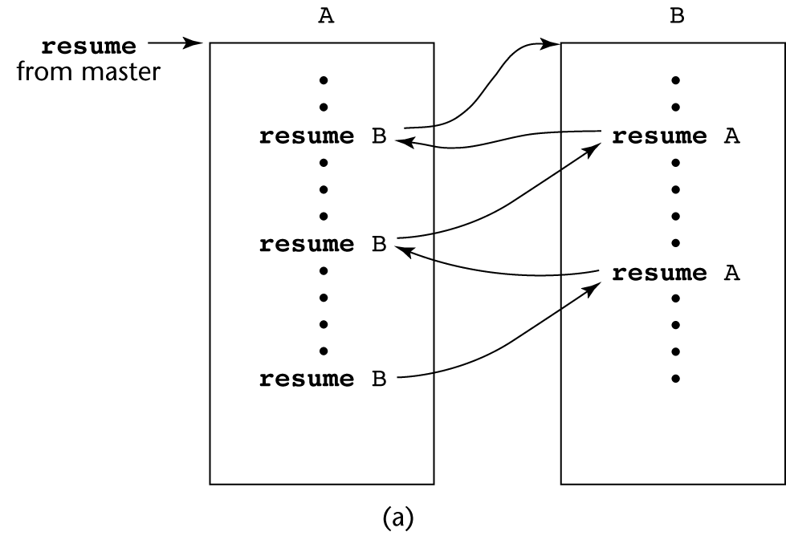
Coroutines

Slide 64
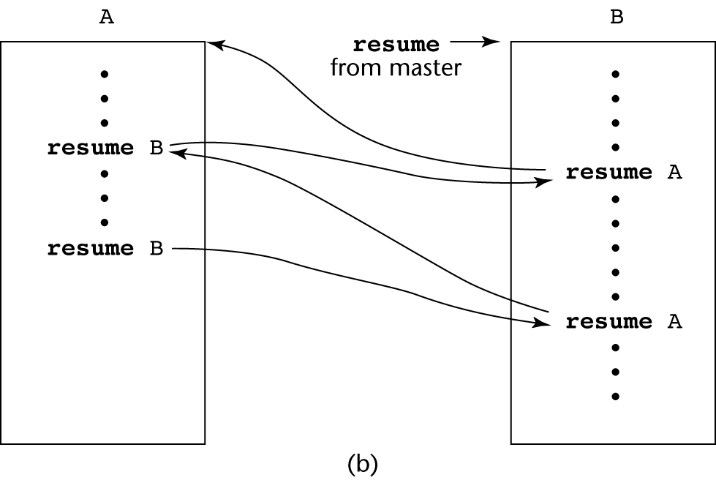
Coroutines

Slide 65
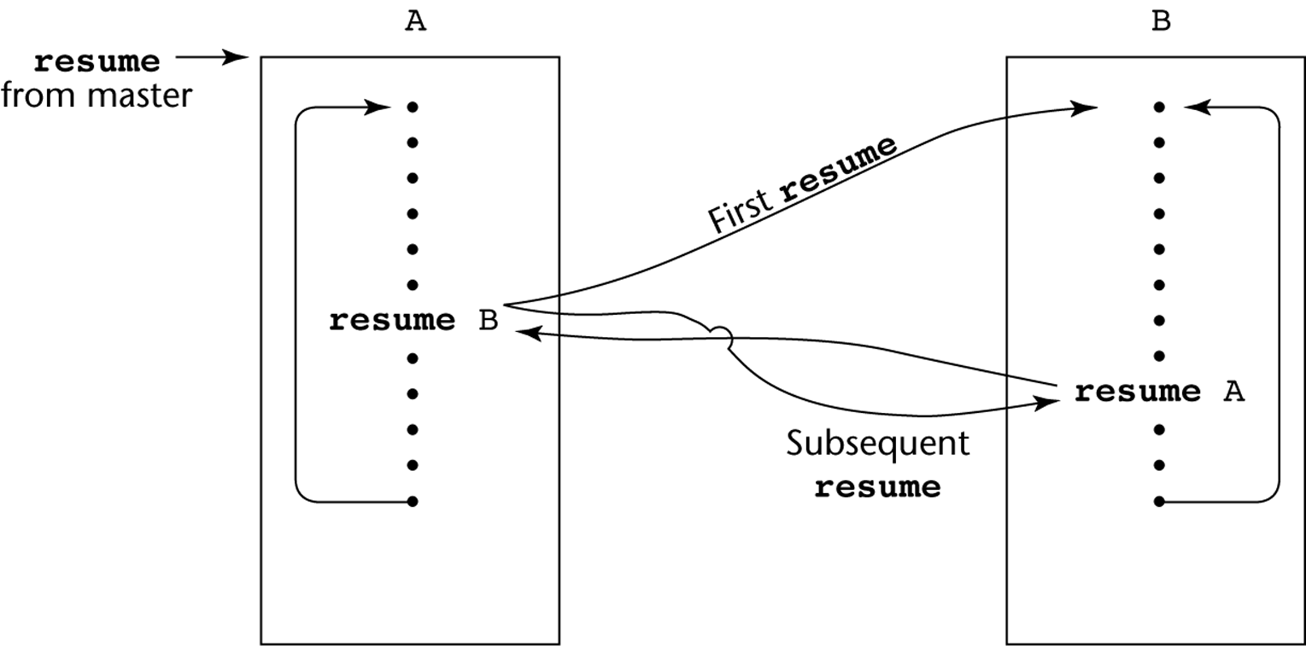
Coroutines

